Slide 1

Career Fair Workshop
Bryan McElvy
Professional Development Chair
Biomedical Engineering Society

Slide 2
Introduction

Slide 3
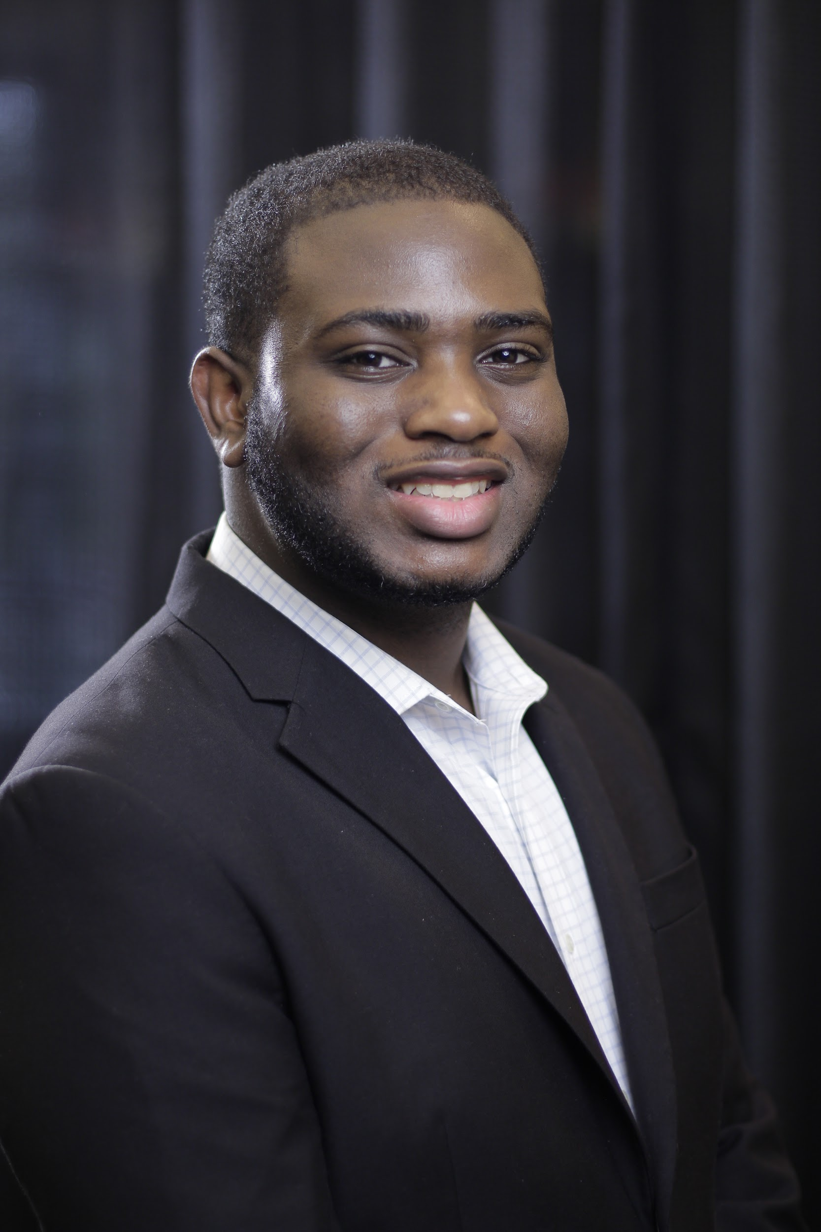
Who am I?
Bryan McElvy
Majoring in Biomedical Engineering, Minor in Data Science
Professional Development Chair
Experience:
Chief Software Engineer for current GBG project
Research Assistant in Clinical Neural Engineering Lab (AKA Dr. Ince’s lab)
Advanced Analytics Intern at Avanade, Inc.

Slide 4
Career Fairs in Fall 2022
Career Fair | Dates/Times/Locations | Registration Info
Engineering Career Fair (In-Person) | Thursday, September 14 10 AM – 3 PM Hilton College | Free for engineering students Priority Registration: Tuesday, 09/13 @ 9 AM – Wednesday, 09/14 @ 4 PM On-site Registration: At the fair
Engineering Career Fair (Online) | Friday, September 23 | Free for engineering students Register on eConnection
WE22 | Thursday, October 20: 2:00 PM – 6:00 PM Friday, October 21: 11:00 AM – 3:00 PM | Early Bird (before 10/01): $125 (SWE Members) $200 (Non-SWE members) On-site/Late (on/after 10/01): $200 (SWE Members) $300 (Non-SWE members)
A few others…look on Cougar Pathway for more info

Slide 5
BME-Relevant Companies @ In-Person Career Fair
UTHealth EP Heart Cardiovascular Electrophysiology Program
  6-month intensive job training program
  Prepares students for jobs in Cardiac Rhythm Management
  $30,000 program fee (less depending on focus)

Slide 6
BME-Relevant Companies @ In-Person Career Fair
UTHealth EP Heart Cardiovascular Electrophysiology Program
  6-month intensive job training program
  Prepares students for jobs in Cardiac Rhythm Management
  $30,000 program fee (less depending on focus)
Cretex Companies, Inc.
  Contract medical manufacturer
  Develops medical components (instruments, cases, trays, stints, etc.)
  Specialize in stamping, laser cutting, CNC machining, plastic injection molding, sterilization/packaging

Slide 7
BME-Relevant Companies @ In-Person Career Fair
UTHealth EP Heart Cardiovascular Electrophysiology Program
  6-month intensive job training program
  Prepares students for jobs in Cardiac Rhythm Management
  $30,000 program fee (less depending on focus)
Cretex Companies, Inc.
  Contract medical manufacturer
  Develops medical components (instruments, cases, trays, stints, etc.)
  Specialize in stamping, laser cutting, CNC machining, plastic injection molding, sterilization/packaging
That’s it!
So many choices, right?

Slide 8
Is it worth going to?
What opportunities does a career provide?
  Potential internships
  Networking
  Further refining your presentation

Slide 9
Is it worth going to?
What opportunities does a career provide?
  Potential internships
  Networking
  Further refining your presentation
The in-person career fair still provides ⅔, so my answer is:

Slide 10
Is it worth going to?
What opportunities does a career provide?
  Potential internships
  Networking
  Further refining your presentation
The in-person career fair still provides ⅔, so my answer is:
YES
You should go

Slide 11
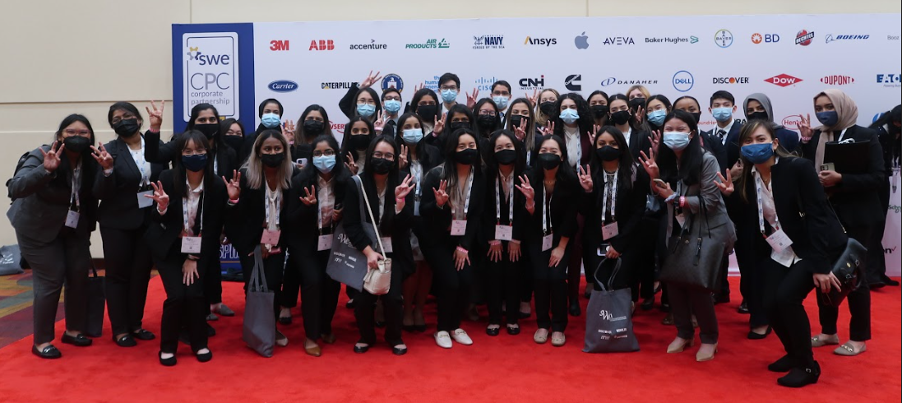
WE22
WE22 is the Society of Women Engineers (SWE) national conference. This year it will be held in Houston on October 20 - 22!
WE22 holds the world’s largest career fair for women engineers and technologists! Companies like Medtronic, Thermo Fisher Scientific, Regeneron, Boston Scientific, Biotronik, Siemens, etc., will be there, making it an incredible
opportunity for BMEs!
Along with this, the SWE-UH
chapter will be holding a ton
of preparation events to help
you succeed at the
conference!!

Slide 12
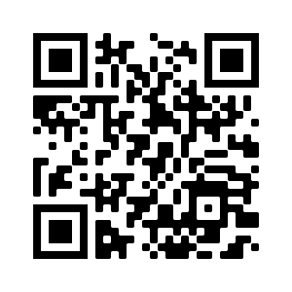
WE22
If you are interested in attending WE22, please fill out the following General Interest form! In doing so, you will be invited to join SWE-UH’s WE22 discord server, where you will receive updates about our preparation events, conference opportunities, and itinerary during WE22!
Please contact Lilly Roelofs at vpi.swe.uh@gmail.com if you have any questions!

Slide 13
Professional Identity
What is identity?

Slide 14
Professional Identity
What is identity?
  Motivations
  Morals
  Goals
  Hobbies
  etc.

Slide 15
Professional Identity
What is identity?
  Motivations
  Morals
  Goals
  Hobbies
  etc.
What is professional identity?

Slide 16
Professional Identity
What is identity?
  Motivations
  Morals
  Goals
  Hobbies
  etc.
What is professional identity?
  Career goals
  Experience
  Technical skills
  Soft skills

Slide 17
Personal Branding
Professional identity is who you are to
Personal branding is how you present that identity
Aspects of personal branding:
  Resume/CV
  Cover Letter
  Elevator Pitch
  LinkedIn Profile
  Real-world presentation

Slide 18
Why is this important?
Good personal branding will help you reach your goals
Bad personal branding will kill even the most qualified applicants’ chances

Slide 19
Why is this important?
How you present yourself can make or break your application
Today, we’ll focus conveying your professional identity through personal branding

Slide 20
Resume

Slide 21
Key Aspects of a Resume
1-page, specifically formatted summary of who you are
Organized into sections (i.e. work experience, projects, volunteering, etc.)
Use consistent formatting
Results-focused – each line should vaguely resemble “AR” from STAR interview method (Situation, Task, Action, Result)
Use action verbs (long list on ECC website)

Slide 22
Example from Bryan’s Resume
“Talked with client-side personnel.”

Slide 23
Example from Bryan’s Resume
“Talked with client-side personnel.”
Bad

Slide 24
Example from Bryan’s Resume
“Talked with client-side personnel.”
Bad
“Communicated with client-side personnel to determine requirements.”

Slide 25
Example from Bryan’s Resume
“Talked with client-side personnel.”
Bad
“Communicated with client-side personnel to determine requirements.”
Good

Slide 26
Example from Bryan’s Resume
“Talked with client-side personnel.”
Bad
“Communicated with client-side personnel to determine requirements.”
Good
“Directly communicated with client-side project leads and product managers to effectively translate business requirements into technical specifications.”

Slide 27
Example from Bryan’s Resume
“Talked with client-side personnel.”
Bad
“Communicated with client-side personnel to determine requirements.”
Good
“Directly communicated with client-side project leads and product managers to effectively translate business requirements into technical specifications.”
Better

Slide 28
Other Resume Tips and Tricks
Order sections based on relevance
  Education should go near the top prior to graduation
  Recruiters: engineers prefer experience, non-engineers prefer extracurriculars
  Skills usually go near the bottom (industry-dependent)
Change your resume to suit a specific position
Develop a “master resume” document
  Long document that lists all of your possible resume items
  Never submit this anywhere; duplicate it and edit into a specific resume
Get your resume(s) reviewed periodically and from different places
  10 different people can have 12 different opinions; get multiple perspectives and decide for yourself!

Slide 29
Elevator Pitch

Slide 30
Key Aspects of Elevator Pitches
30-60 second spiel on who you are
Not necessarily the first thing you say; direct/allow convo to reach it naturally

Slide 31
When preparing an elevator pitch, DO…
…include relevant educational info (major/minor, classification, graduation date)
…discuss 1-2 relevant experiences
…talk about your career goals and interests (i.e. technical skills, career path)
…mention extracurriculars (volunteering, organizations, leadership)
…mention why you’re interested in that company (i.e. specific products, unique aspects, mission statement)
…include any other information that you feel is relevant to explaining who you are

Slide 32
When preparing an elevator pitch, do NOT…
…say it like a prepared speech (practice/rewrite until it sounds natural)
…run too far over 60 seconds (talk WITH them, not AT them)
…go into too much detail (leave non-surface-level details for further convo/interviewing)
…describe every item on your resume (same as above)
…give equal time to every “section” (put more focus on either experience or whatever you feel is most important)

Slide 33
Final Note on Personal Branding
DON’T LIE
Act confident; don’t let others know about imposter syndrome
Most of this is subjective; decide for yourself what info is best for you to represent yourself with

Slide 34
Acquiring Experience

Slide 35
How do I acquire experience for industry?
Class projects
  Least valuable; doesn’t differentiate yourself from others
Projects
  Can build off of classwork
  Personal projects show initiative
  Group projects show teamwork skills
Research
  Still counts as experience; can teach relevant technical skills
  Especially good for R&D roles
  Accomplished through on/off-campus volunteering and paid research experiences (i.e. REUs, SURF, PURS)
Internships/Co-Ops
  3-7 month work experience
  Internships are summer; co-ops are fall/spring
  Don’t take unpaid internships

Slide 36
Conclusion

Slide 37
Conclusion
Gaining relevant experience is important for engineering students; it’s MORE important for BMEs
Everything you do contributes to your professional identity
Personal branding is an essential part of getting opportunities

Slide 38
Conclusion
Gaining relevant experience is important for engineering students; it’s MORE important for BMEs
Everything you do contributes to your professional identity
Personal branding is an essential part of getting opportunities
Finally,
Professional Development Workshops will be hosted throughout academic year.
Stay tuned for more info!

