Slide 1
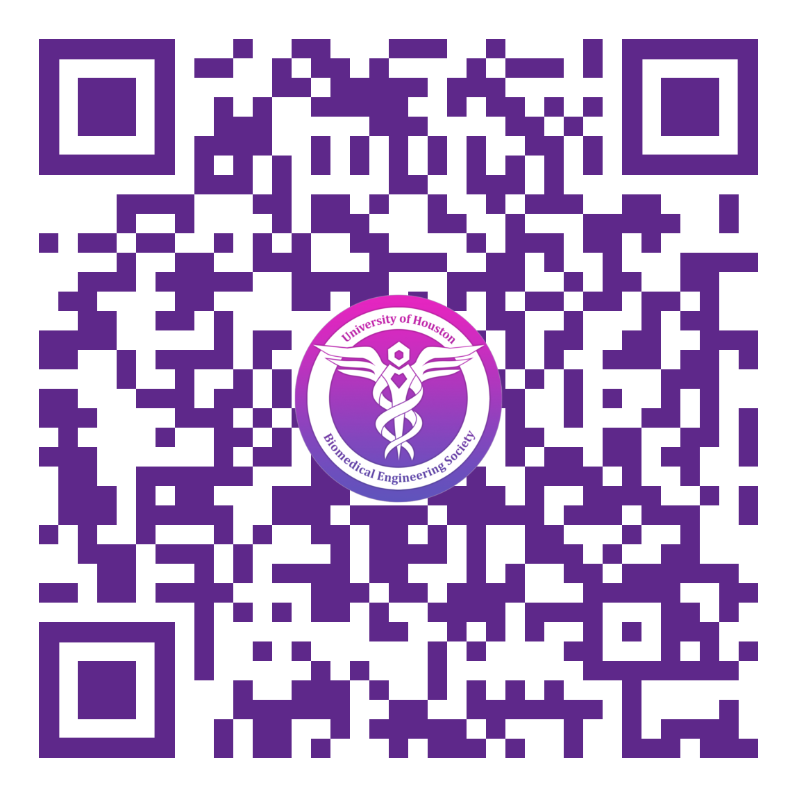
Attendance
General Attendance Form
Points
Timeliness
This same form can be used to check in for all BMES events. Just fill in the required information, and select the appropriate event
Members earn points for attending BMES and select college/university events. Make sure to check in to each event to earn points.
Form submissions are timestamped. If you’re checking into an event late (not the same day), please shoot Mik a message with a brief statement about the event (maybe what you did, if you talked to anyone there, your favorite part etc). If you don’t, you’ll probably get an email.

Slide 2

1st General Meeting

Slide 3
WHO WE ARE
The Biomedical Engineering Society at UH is dedicated to facilitating the best experience possible for student success academically and professionally. We are a place for you to meet students within the major through our social events, to network with individuals within the industry through our educational and professional workshops, and to obtain applicable experience through hands on projects. Most importantly, we will be the catalyst to helping you define what it means to be a BME.

Slide 4
WHAT IT MEANS TO BE A BME(S MEMBER)
THE JOURNEY
OUR MISSION
This degree gives you knowledge within coding, circuits, mechanics, and organic chemistry.
Encourage you to push through this rewarding experience by providing the best smooth sailing experience through this degree.

Slide 5
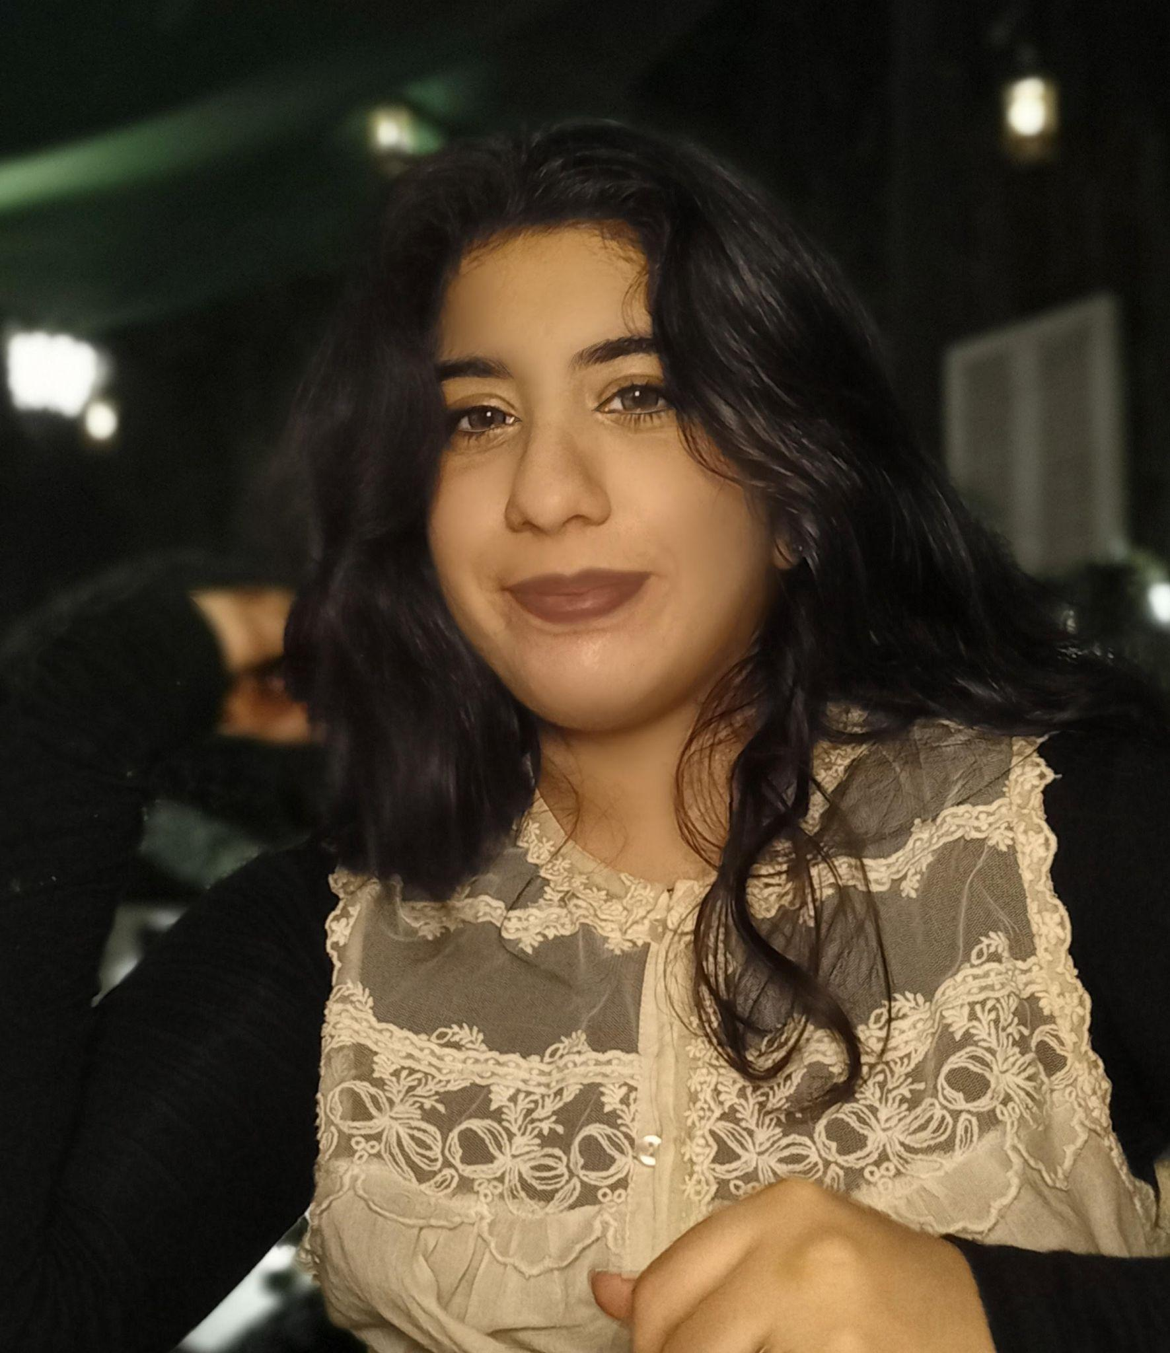
President
Shanzeh Imran
Track: Bionanoscience
Year: Senior
Fun Facts About Me:
I am an international student from Pakistan
I love playing competitive Pokemon
I have a black cat named Eevee
I am doing research on the blood brain barrier in Dr. Mohan’s lab

Slide 6
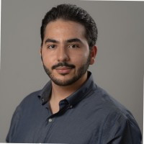
Vice President External
Rogelio Castilla
Track: Bionanoscience*
Year: Junior/Senior
Fun Facts About Me:
I sleep orthogonal to my sleeping bags. If you know you know…
More seriously, I practice Brazilian Jiu Jitsu here on campus with friends. Come out to roll!
I like to work on space technology design projects! Last semester I worked on a UAV for a mission to Enceladus with students from Bauman Moscow State University.

Slide 7
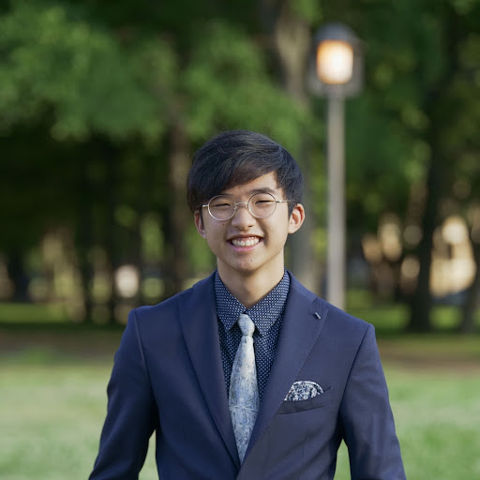
Vice President Internal
Brendan Wong
Track: Pre-Med
Year: Senior
Fun Facts About Me:
Ghibli Fan (Howl’s Moving Castle)
Badminton/Tennis Player
Mobile Gamer (Tower of Fantasy)

Slide 8
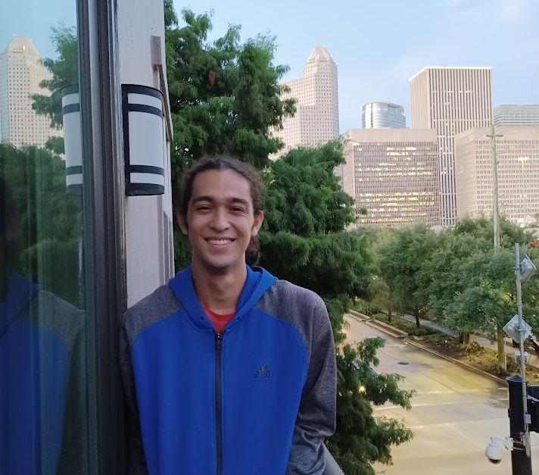
Outreach Coordinator
Wesley Cherry
Track: Bionanoscience
Year: Senior
Fun Facts About Me:
I’ve been with BMES for 4 years
I like to draw and play guitar…. and game and like… a lot of other stuff. I have way too many hobbies…
Gigaweeb (I like anime)
Hololive ftw

Slide 9
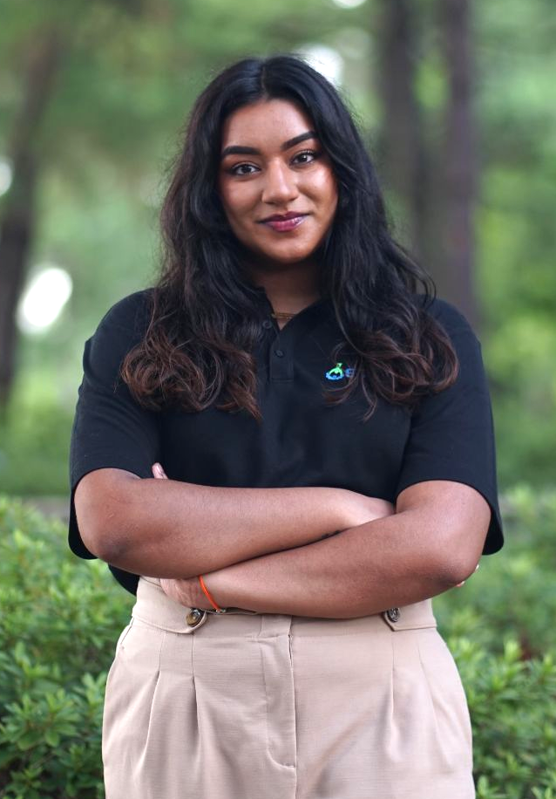
Treasurer
Jasmine Dhaliwal
Track: Neural, Cognitive, & Rehabilitation Engineering
Year: Super Senior
Fun Facts About Me:
I own 2 birds
I’m an older sister
I like playing Assassin’s Creed
I can roller skate backwards
I love learning about different languages, cultures, customs, etc.

Slide 10
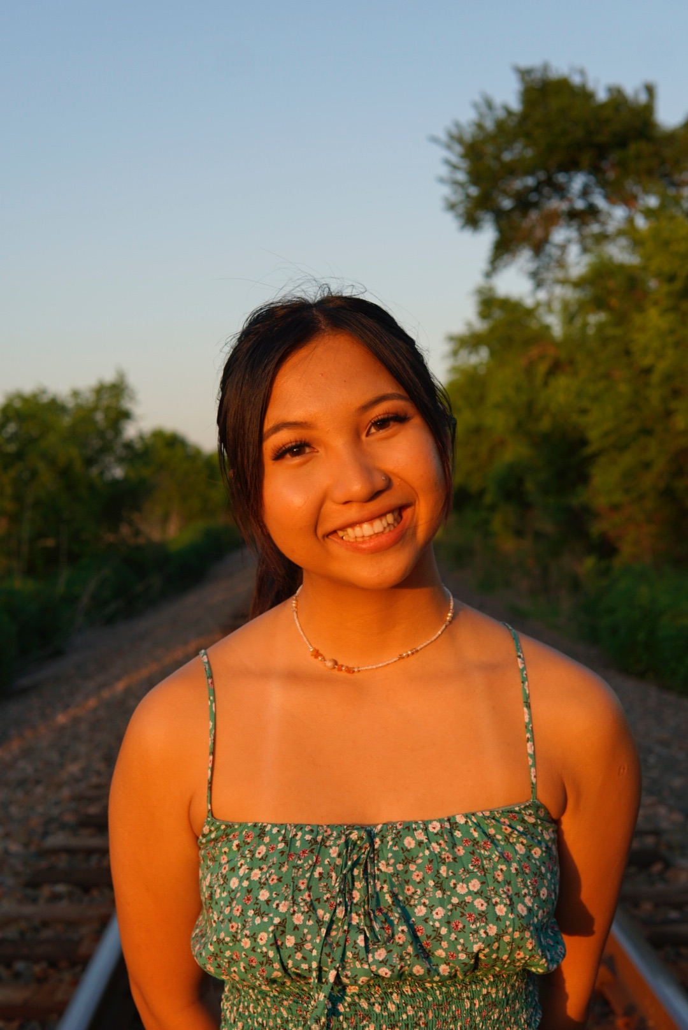
Secretary
Bonny Le
Track: Undecided
Year: Sophomore
Fun Facts About Me:
I love to boulder (aka rock climbing without the rope)
I sleep ALOT ALOT
I am interning for Legacy this year as a Health Advocate

Slide 11
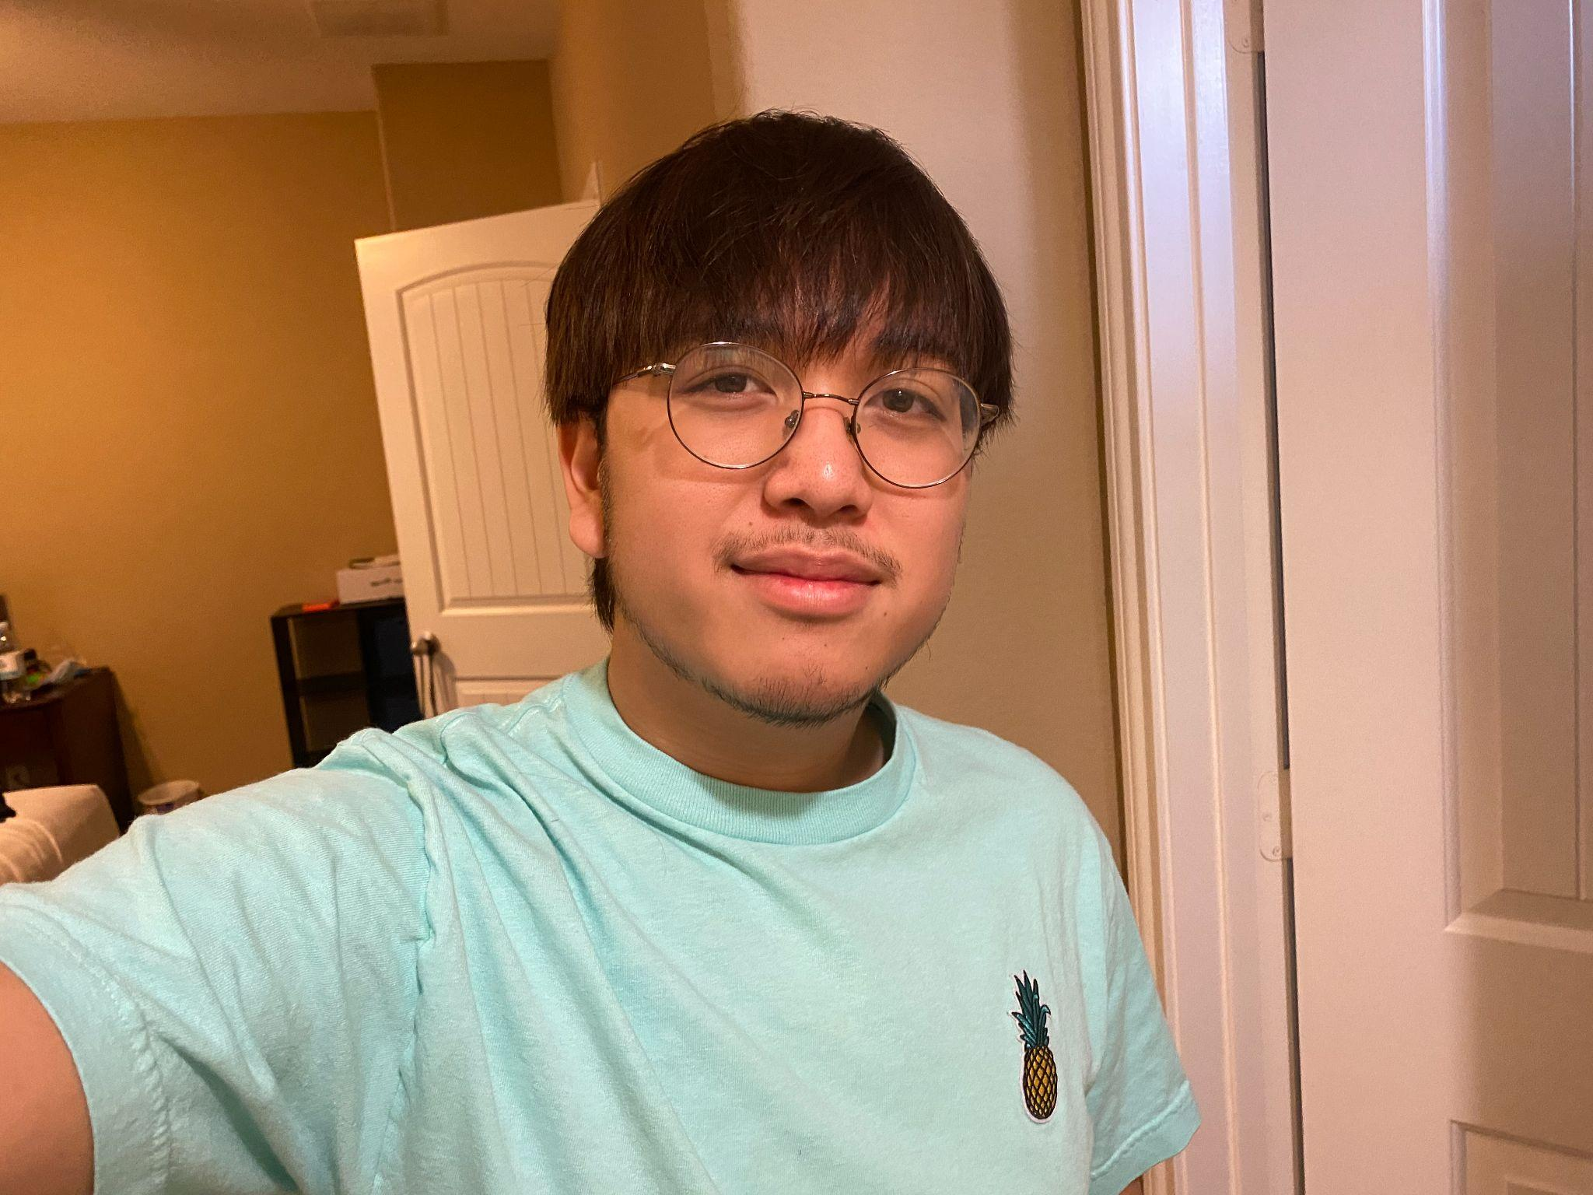
Webmaster
Marcus Tubera
Track: Neural, Cognitive, and Rehabilitation Engineering
Year: Junior
Fun Facts About Me:
I have 5 dogs
I used to be in gymnastics
I’m doing research on stroke rehabilitation in Dr. Roh’s lab

Slide 12
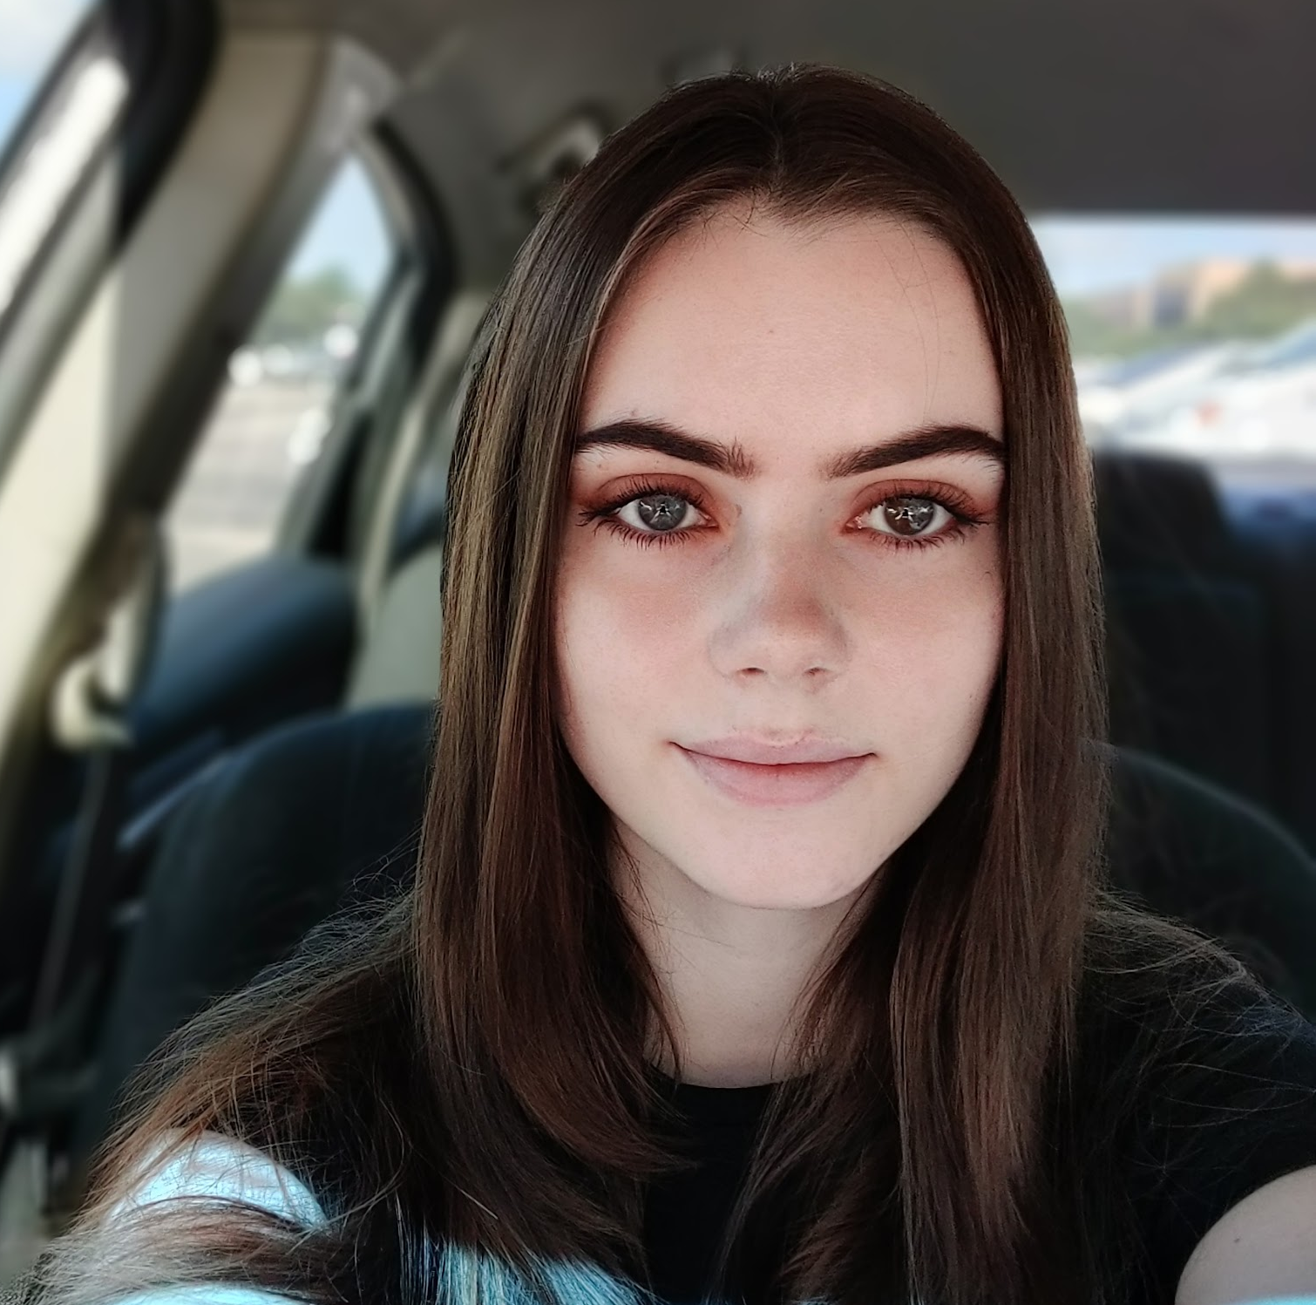
Membership Chair
Mikayla (Mik) Deehring
Track: Neural, Cognitive, and Rehabilitation Engineering
Year: Senior
Fun Facts About Me:
Bleach is my favorite anime
I work in R&D at a startup
I work with accelerometers to collect data from Parkinson’s patients in Dr. Ince’s lab

Slide 13
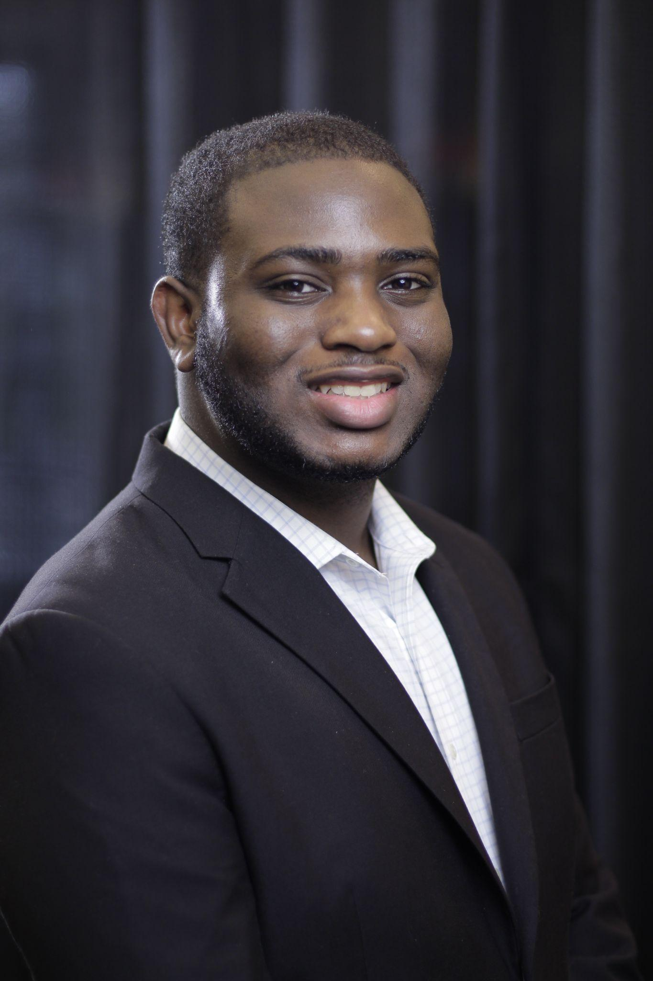
Professional Development Chair
Bryan McElvy
Track: Neural, Cognitive, and Rehabilitation Engineering
Year: Super Senior
Fun Facts About Me:
Completed an Advanced Analytics Internship @ Avanade this summer
Minoring in Data Science
Was once able to solve a Rubik’s Cube in 38 seconds

Slide 14
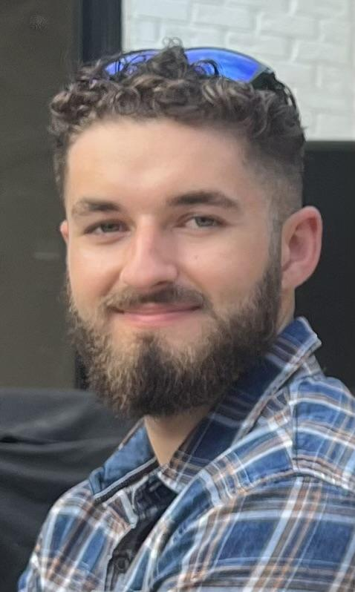
Public Relations Chair External
Cullen Domingue
Track: Neural, Cognitive, and Rehabilitation Engineering
Year: Junior
Fun Facts About Me:
I love to travel
I am a gym rat
I used to play competitive airsoft
5000 combined hours between sly cooper, skyrim, and rainbow 6 siege

Slide 15
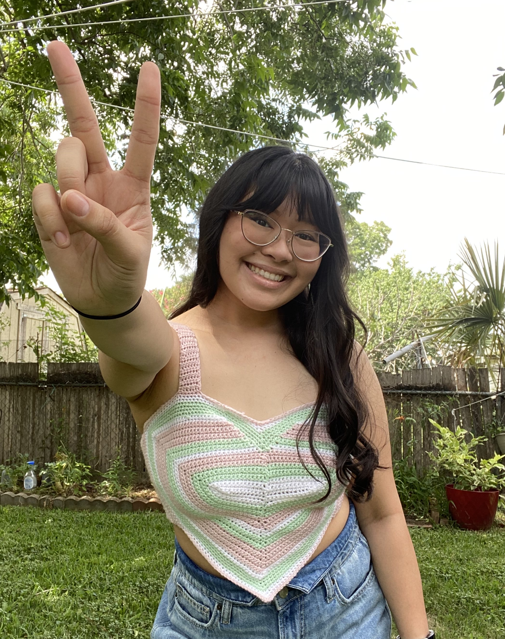
Public Relations Chair Internal
Hannamarie Ecobiza
Track: Neural, Cognitive, & Rehabilitation
Year: Super Senior
Fun Facts About Me:
I love to crochet!
I can play 10+ instruments
I have two twin pups :)

Slide 16
Connect With Us!

Slide 17


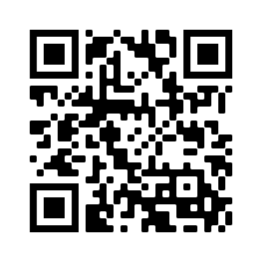




Instagram
@uhbmes
Snapchat
@uh_bmes
GroupMe
TikTok
@uhbmes
YouTube
@UH BMES
Website
uhbmes.wordpress.com

Slide 18

BeReal Fundraiser
Join us on BeReal to raise money for BMES!
To help us raise money:
Download BeReal and make a NEW account this week
Add 5 friends
Have notifications turned on
Make at least one post
Earn 5 membership points for joining!
For every friend referred, you get one membership point!
Member with the most points will receive a gift card!

Slide 19

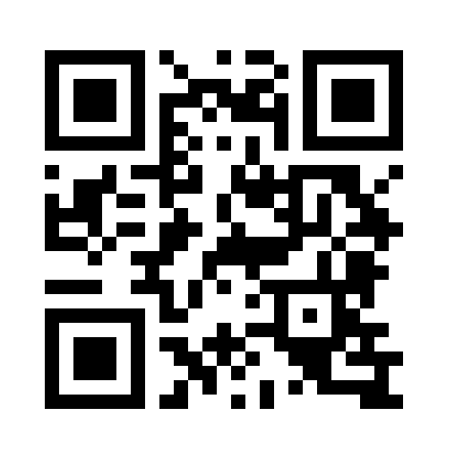
Subscribe!
To Our Weekly Newsletter to get the latest scoop!

Slide 20
Paid Member Benefits
 | Paid | Unpaid
Workshops | Access to workshops lead by experienced upperclassmen and industry professionals | Not open to non-members
Go Baby Go | Participate in designing and building mobility devices for diabled children | Non-members can participate* *they will not get their name on technical papers or get points for participating unless approved by project lead.
Point System | Accumulate points for attending BMES and college events to compete for prizes | Points are tracked, but nonmembers are not eligible for prizes
Mentorship Program | Partner experienced upperclassmen with other students to provide guidance. | Not open to non-members

Slide 21


Dues Deadlines
How To Pay
Venmo
$25
Cash
$35
Early Bird
@UH_bmes
After 2nd GM
Please coordinate with treasurer or officer for payment

Slide 22

T-Shirt Design
T-shirt design contest winner: Alejandro Rivera!
We will announce when they come in
If you pay dues, you can pick it up in the lounge!
  Engineering 2 Building (W227)

Slide 23
Top Members of Last Year
Bryan McElvy
Marcus Tubera
Victor Johnson
1st Place
2nd Place
3rd Place

Slide 24
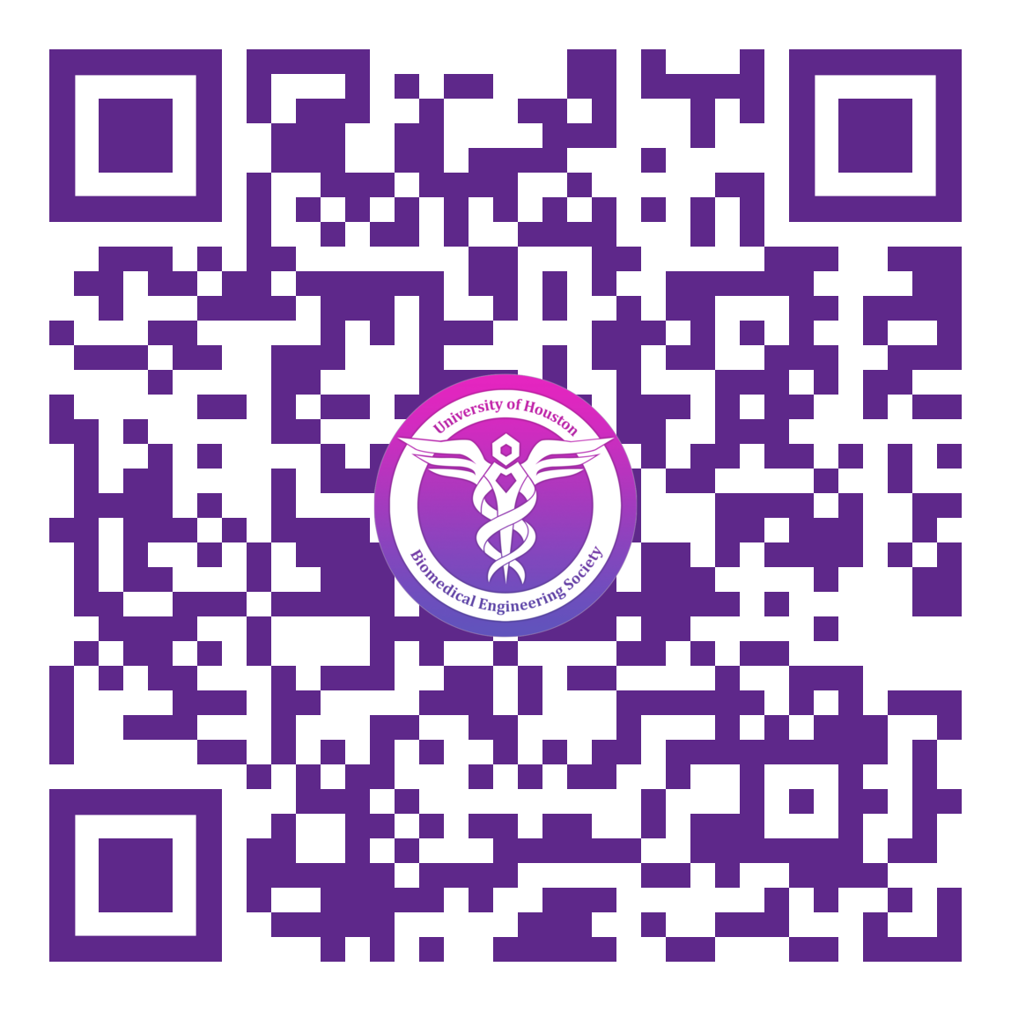
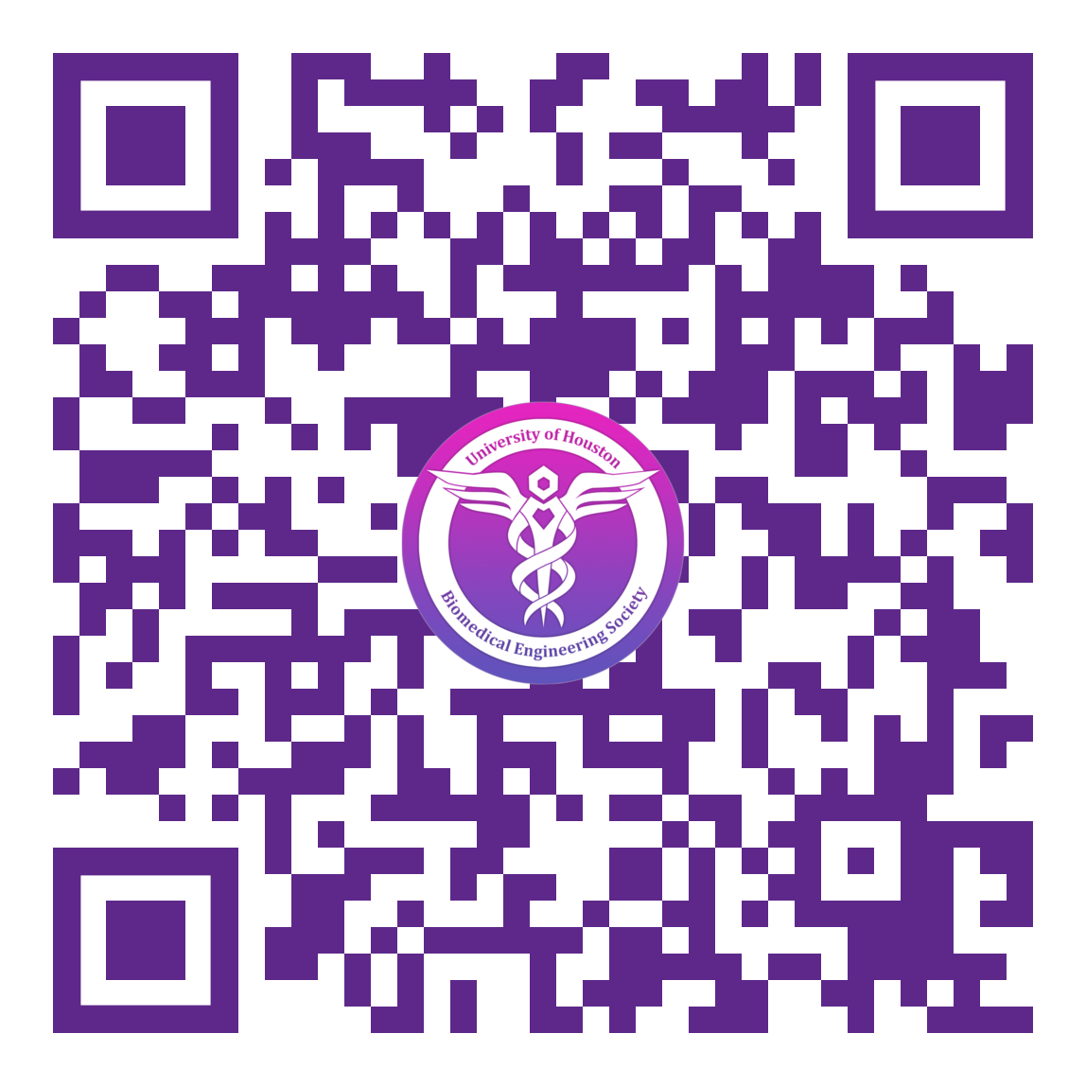
Peer Mentorship Program
About the Program
Mentee Survey
Mentor Survey
Mentors and mentees will be paired up based on their responses on their respective surveys.
Google Classroom assignments will be available to complete for points (prizes will be awarded for most active teams), but mentors will coordinate their exact mentorship style individually.
Soft deadline for survey submission is September 21, but we will attempt to make/find suitable pairings for individuals who submit surveys after the deadline.
Questions, problems, and concerns can be directed to Mik on GroupMe or Discord.
Scan the above QR code if you would like to participate as a mentee.
Scan the above QR code if you would like to participate as a mentor.

Slide 25
Upcoming Events
Engineering Career Fair
Bowling Social
Hilton Hotel
Student Center Games Room
9th Sept
15th Sept
23rd Sept
26th Sept
12th-15th Oct
Houston Food Bank
Virtual Career Fair
BMES Conference
With Phillips 66
eConnection
San Antonio
Notes:
So here is a list of upcoming events for this month and next
First up is the HFB volunteering event on Sept 9th from 7:30 AM to 1 PM. You can scan the QR code that is on the flyer to get access to the volunteer form. And if you’re interested, we’re also looking to setting up a carpool system so make sure to join the corresponding groupme so you can arrange that
Next up, we have two career fairs organized by the college of engineering coming up. Bryan will talk more about this later on in tonight's meeting but highly recommend anyone to attend no matter what classification you are (whether it be for exp or job search)
You can also look forward to the first social of this year which will be the bowling social. If you’re looking to meet new people within the org or major,
The National BMES is also coming up. More details about that later.
Again make sure to follow our socials to keep up with future events that we will have. in october, you can also look forward to our upcoming workshops: internship

Slide 26
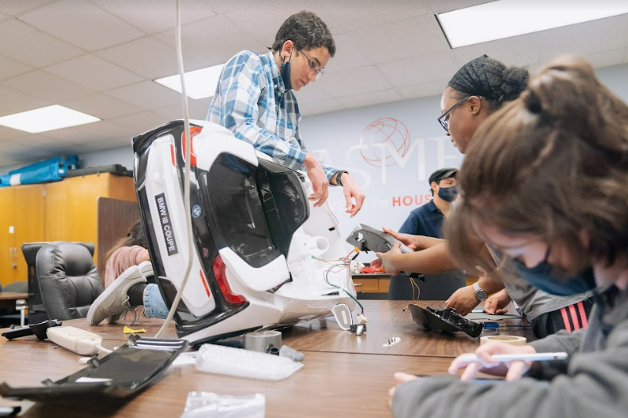

GO BABY GO (with ESIDE)
Go Baby Go is a program started in the University of Delaware. The project spread nationally (and internationally) and now we get the opportunity to help children! The Project’s purpose is to provide access for children with certain disabilities to a modified toy car. This allows an economic alternative for a wheelchair.
This year we are putting together the finishing parts of last semester’s project. The vehicle includes motor control based on accelerometer and gyroscope values gather from a MPU 6050 sensor and will help a girl with axonal motor neuropathy!
GBG availability will be determined by the end of the week. If you plan to participate make sure to vote on the schedule:

Slide 27
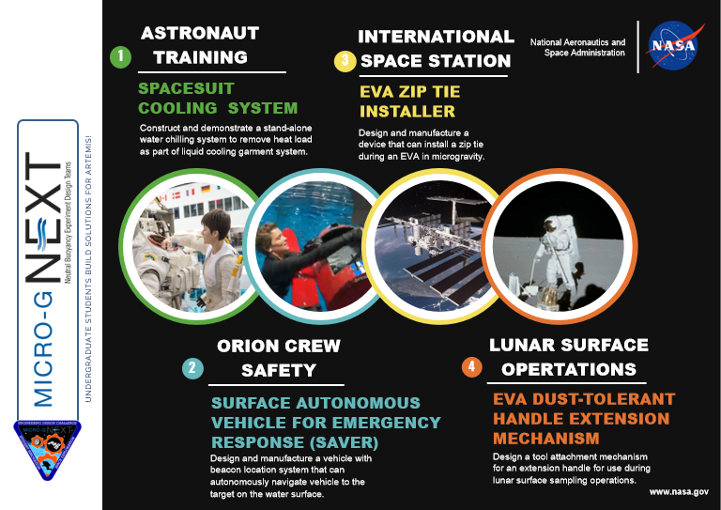
NASA MicroG Next
BMES Team Topic: Spacesuit Cooling System
Purpose: Construct and demonstrate a stand-alone water chilling system to remove heat load as part of a liquid cooling garment system
Skills and applications:
Electrical and circuit applications
Human interfaces.
Mechanical design focused on buoyancy, and temperature regulation..
CAD (Fusion 360 and SolidWorks).
Work through the whole design process with a team of engineers.
Opportunities:
Network with engineers, NASA staff, and team mentor.
Prize money and award for top finalists.
Valuable project experience.
Important Dates:
September 15 2022 - Information Session
October 13 2022 - Letter of Intent due
October 26 2022 - Proposals are due

Slide 28
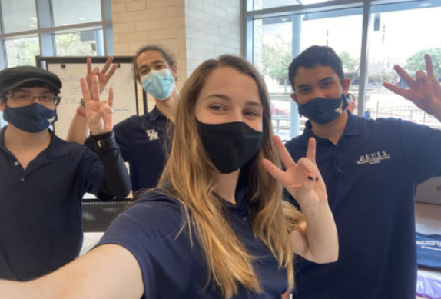
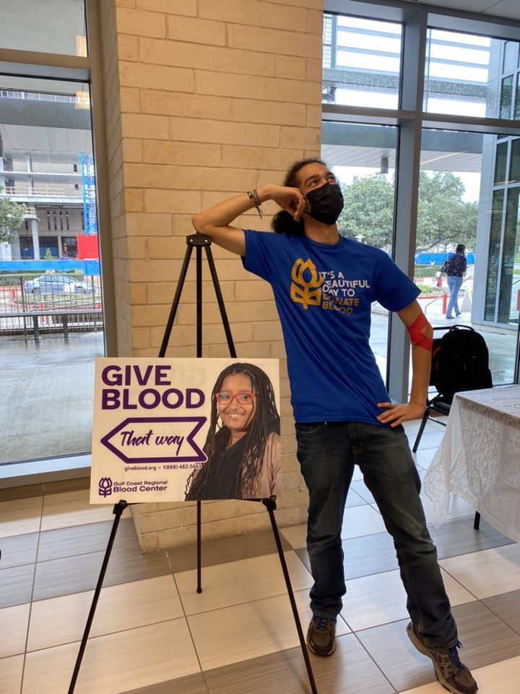


GULF COAST REGIONAL
Blood Drive will be Tuesday, September 27th from 12-6 on the bus in front of the Student Center
Sign up link will be sent out

Slide 29

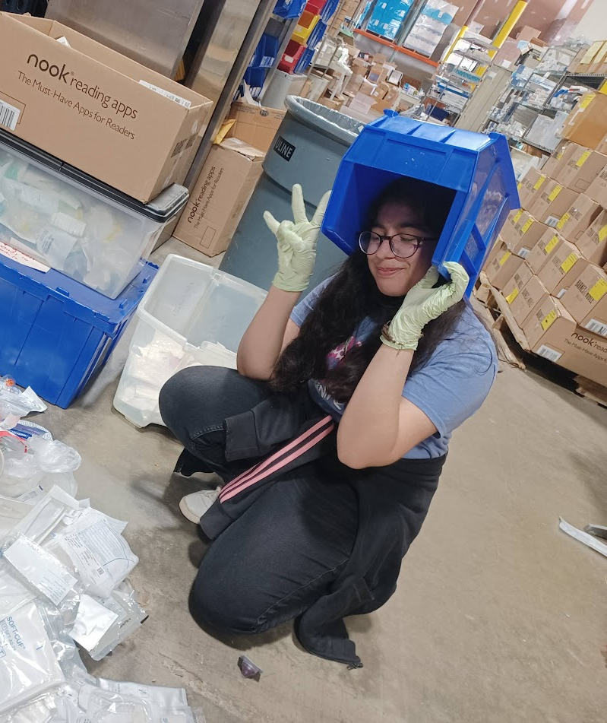
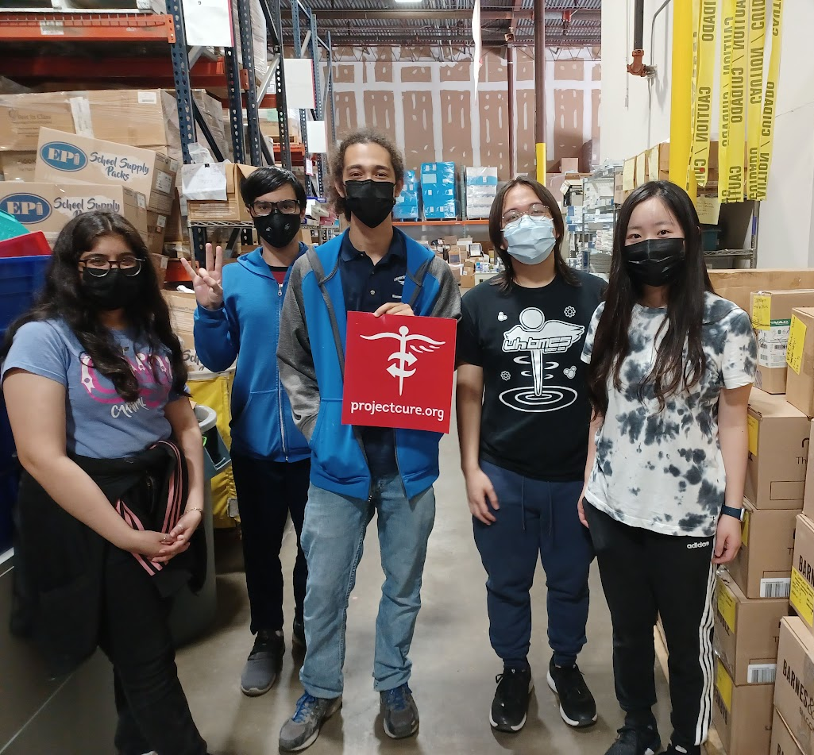
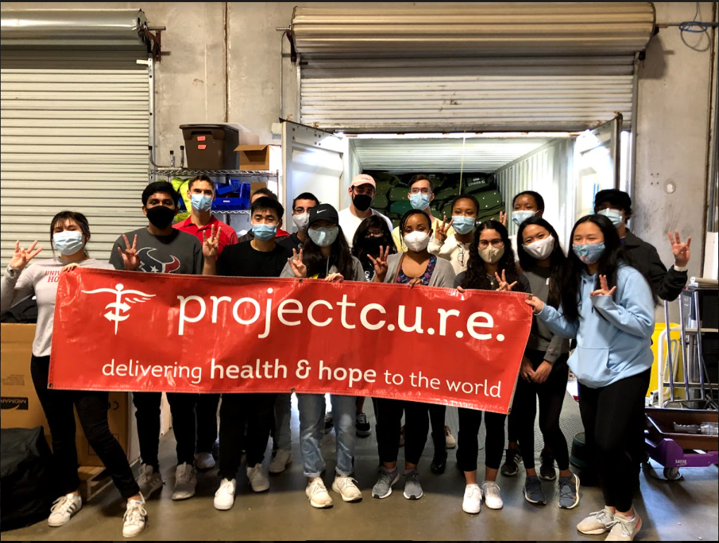
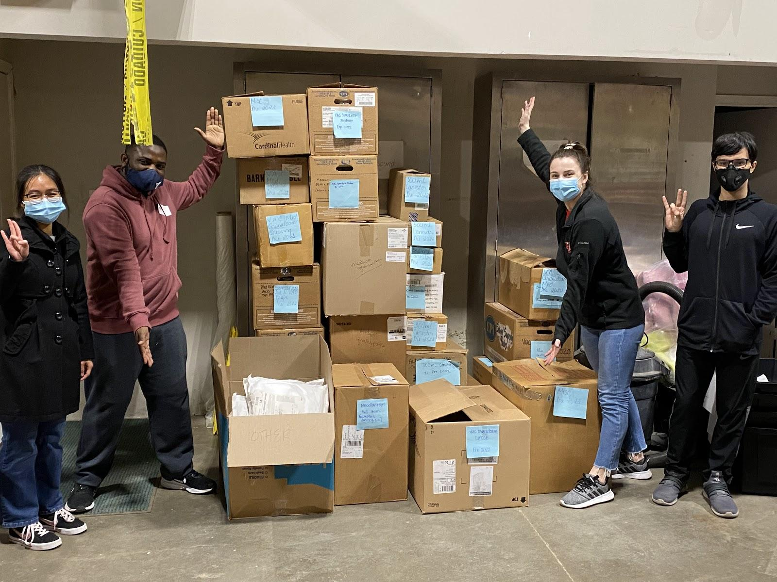
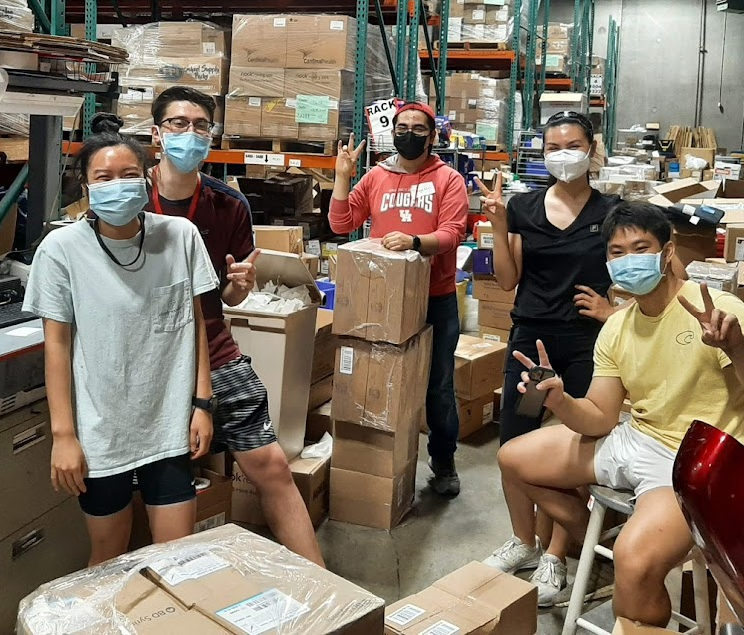
Project C.U.R.E
Dates TBA!

Slide 30

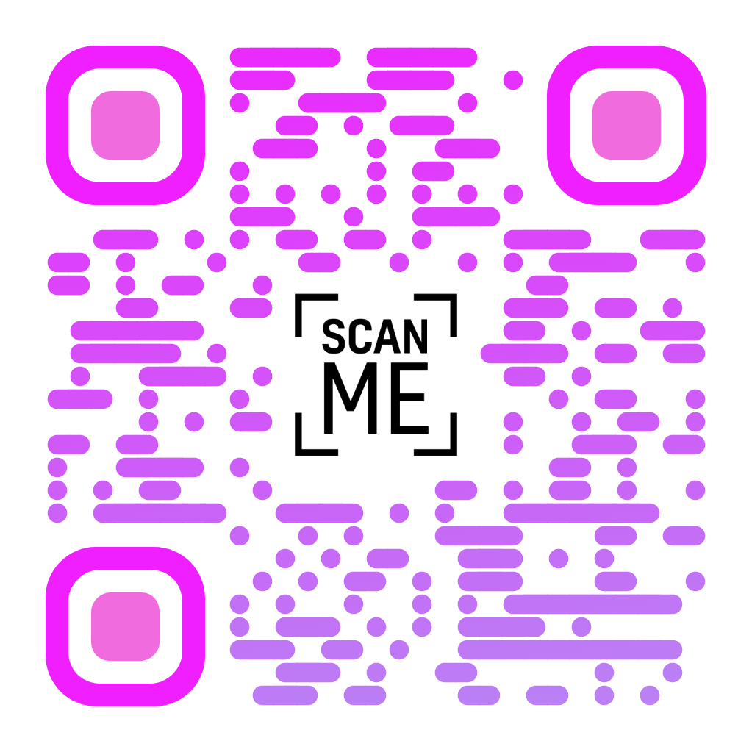
This year BMES is holding its annual conference in
San Antonio.
In additions to companies like Biomomentum Inc, representatives from
organizations like the NIH, NSF, and prestigious programs like ENMED, John Hopkins, and Cornell university will be present. This is a great opportunity for network and professional development!
In addition, additional mixer events as well as research abstract and the medtronic student design competitions will take place. If you can, do take advantage of this year’s opportunity to attend the annual convention taking place in state!
Register!

Slide 31
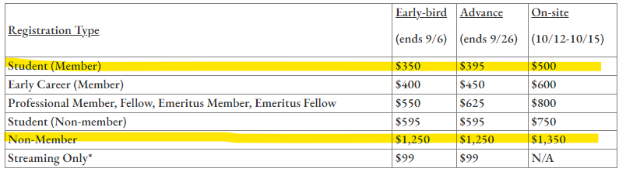
BMES National Conference Registration

Slide 32
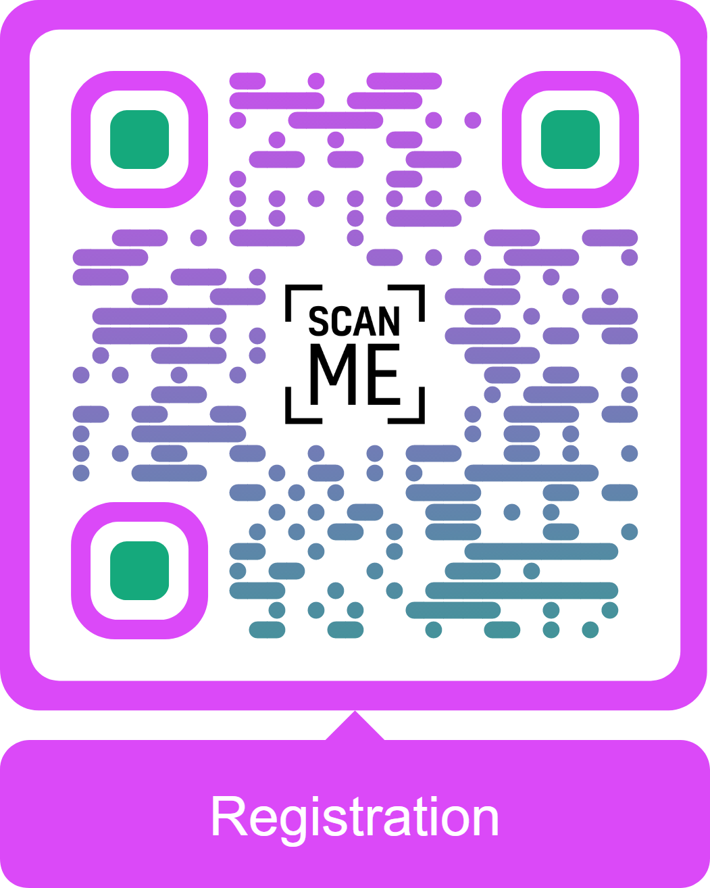
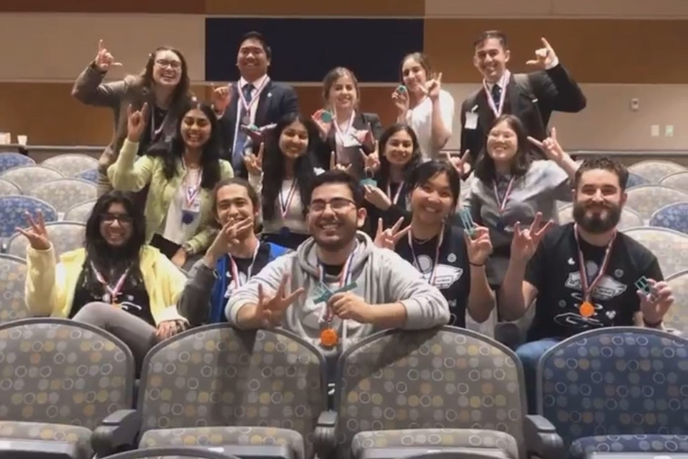
5th Annual Medical Device Make-a-thon
When and Where?
Why should I go?
The Medical Device Makeathon will be held on February 24-26th, 2023. TAMU College Station.
Apart from the Ws, fame, and unending glory, you will have to opportunity to network with other students and local health professionals. You will also learn new prototyping and specific design software skills (such as Solidworks and 3d printing splice software and techniques). Did we mention the potential to win prize money?
Details about registration and teams:
Open until Jan 14 2023.
Its 30 USD before Jan 1 2023, and 35 afterwards (individual).
Members must have four to five members.
At least 2 of the teammates must be freshmen or sophomores.
Not limited to same major or even Uni!

Slide 33
THANKS!
Any Questions?

