Slide 1
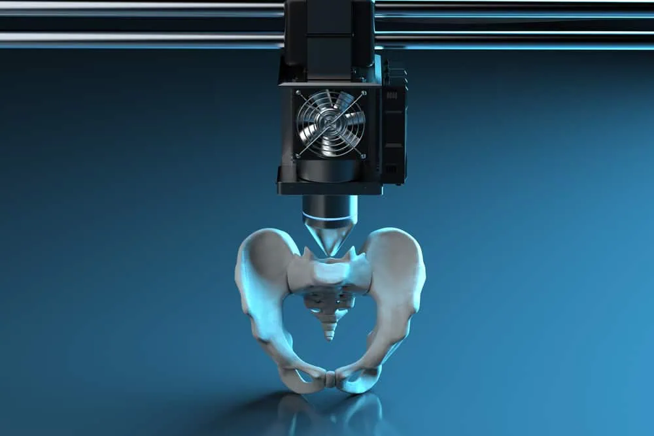

Intro to 3D Printing for BME
Attendance Form

Slide 2
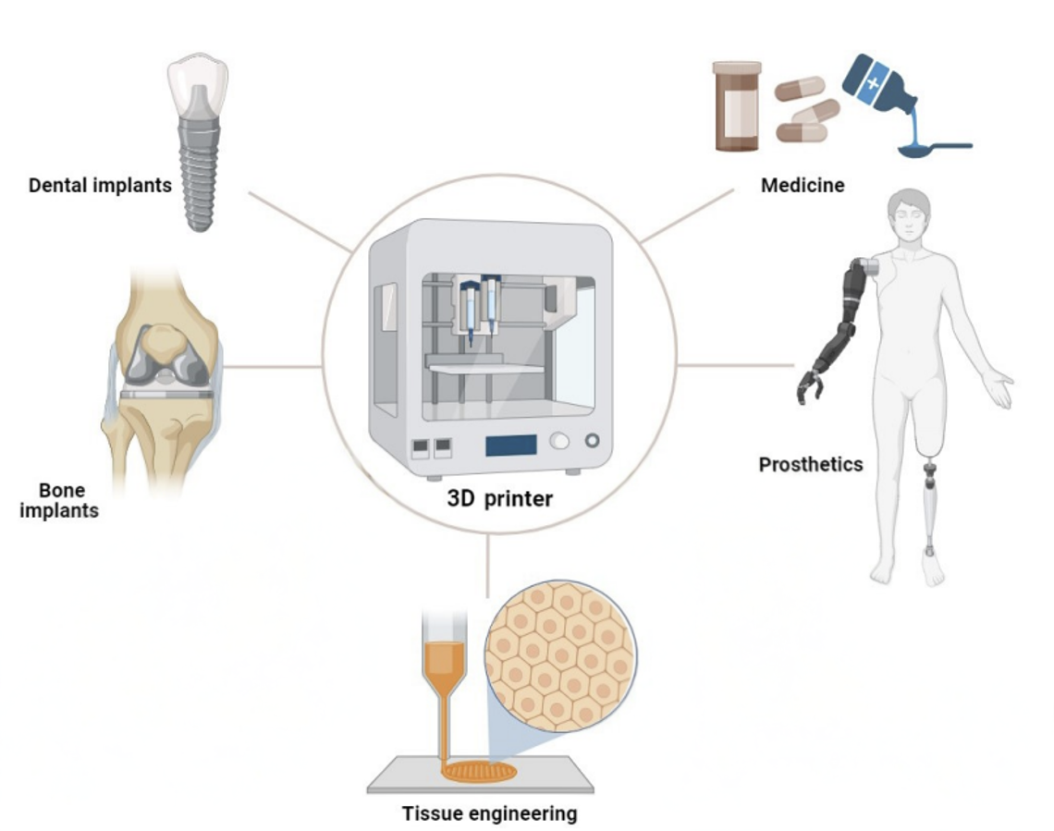
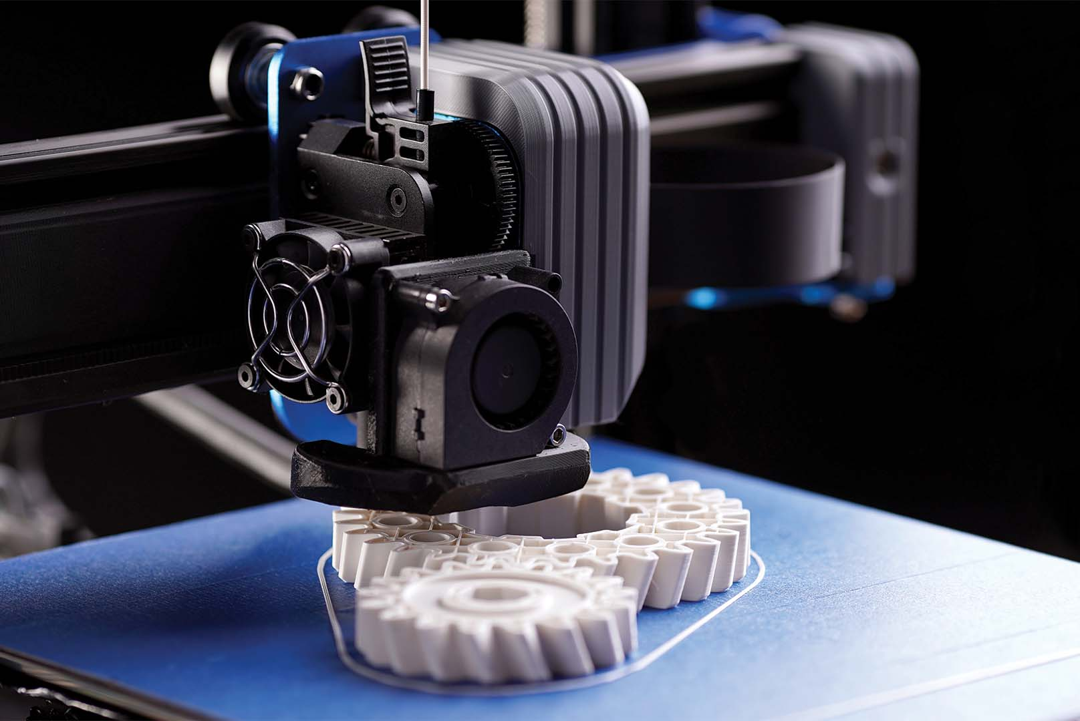
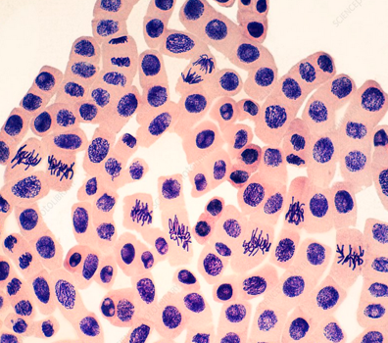
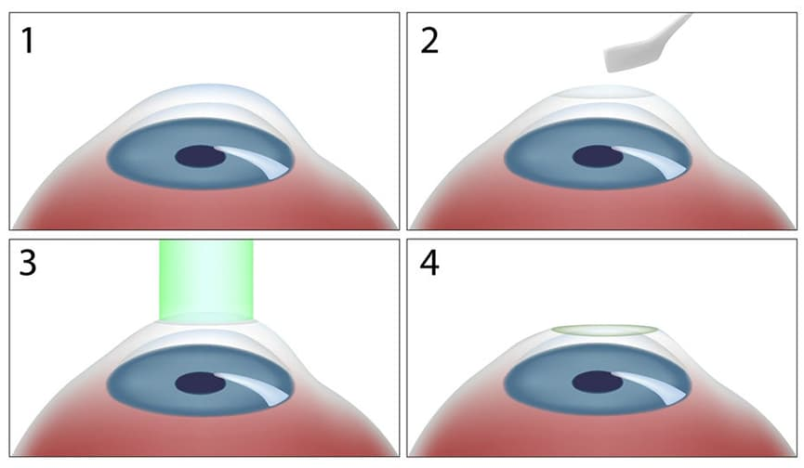

What is 3D Printing?
Additive Manufacturing
Stereolithography (SLA)
Subtractive Manufacturing
Fused Deposition Modeling (FDM)

Slide 3
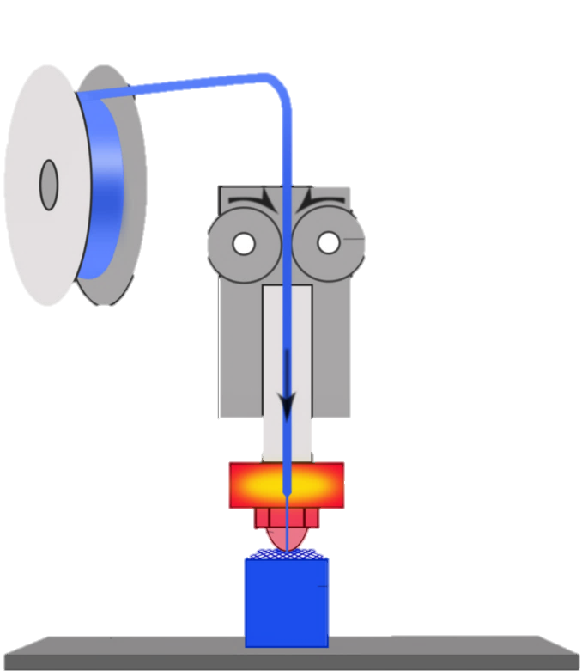
FDM Printer Terms
Extruder
“The extruder isn’t extruding”
Filament
“I love the filament fumes!”
(Heated) Nozzle
“The nozzle is clogged”
(3D) Print
(Print) Bed
“The Print came out wrong”
“The print didn’t stick to the bed”

Slide 4
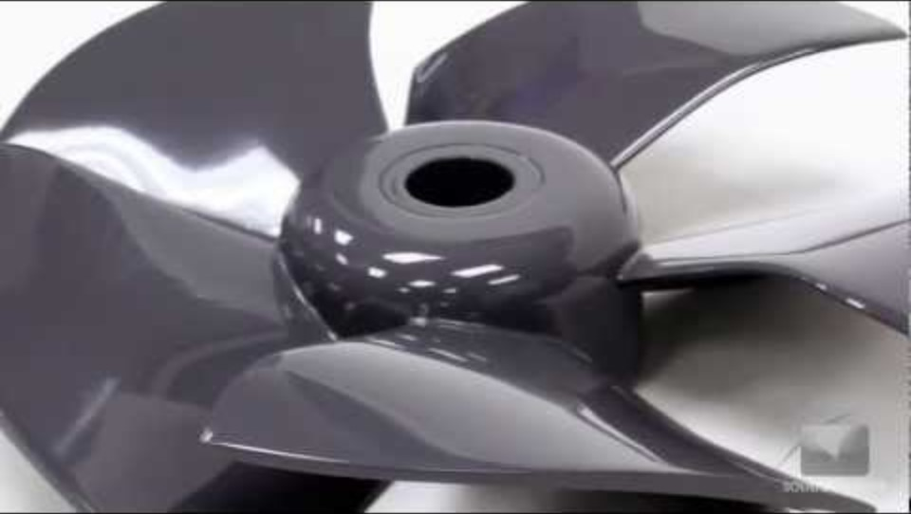
FDM Printer Anatomy

Slide 5
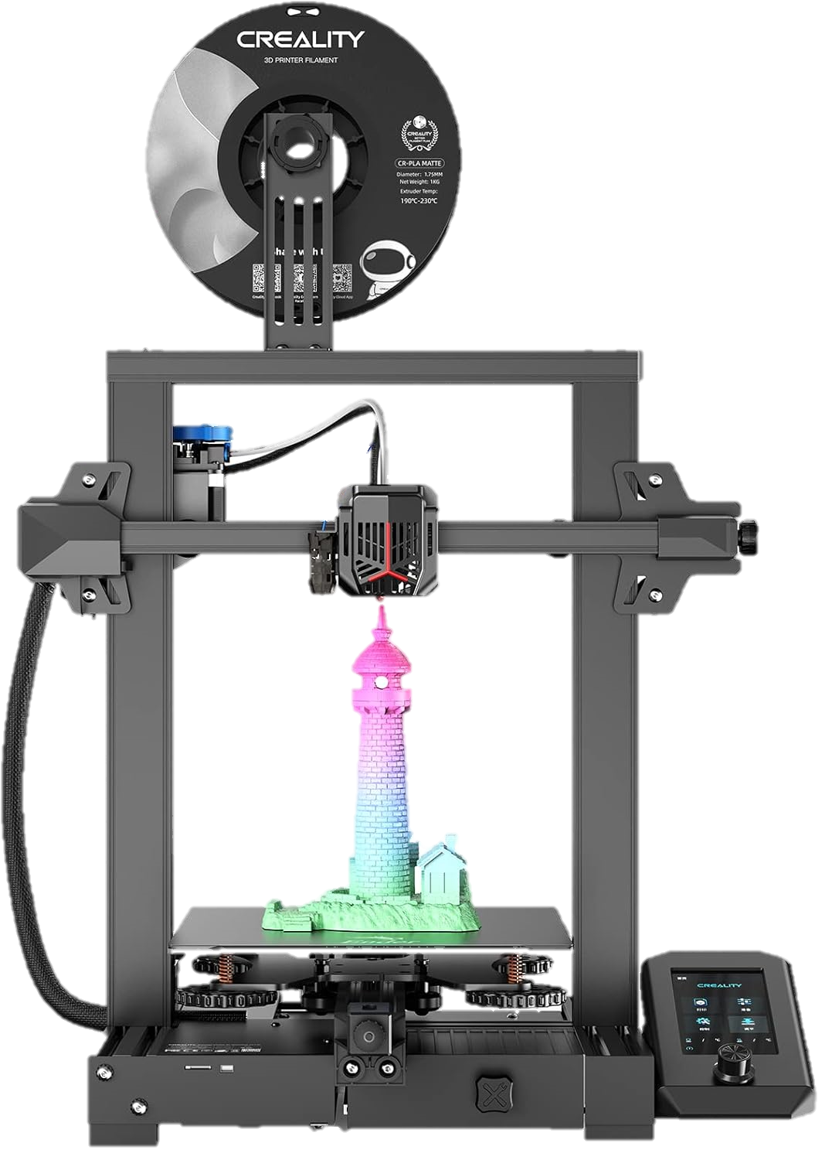
The UH BMES Printer
Model: Ender 3 V2
Area: 220 [mm] x 220 [mm] x 250 [mm]
Resolution: 0.1 [mm] – 0.4 [mm]
Max. Nozzle Temp: 250˚C / 482˚F
Max. Bed Temp: 110˚C / 230˚F
Heat up Time: 5 minutes

Slide 6
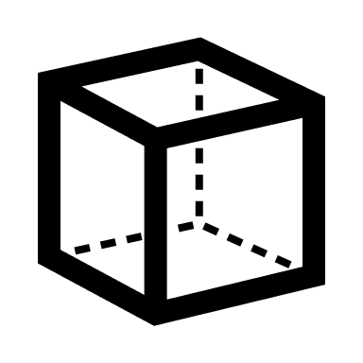

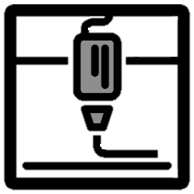






3D Printing Process
Modeling
Slicing
Printing
.dwg
.stl
.gcode
.stp
.3mf
.x3g
Printer Screen

Slide 7
Designing a Model
3D Computer-Aided Design (CAD) Programs
3D Printing-Specific Considerations
TinkerCAD
FreeCAD
Autodesk Products
  Inventor
  Fusion
  Provided to UH Students
SOLIDWORKS
Horizontal plane has more resolution than vertical plane
Maximize Bed Contact
  Minimizes Support Structures
Fillet/Chamfer edges when possible
  Prevents warping due to cooling and thermal stress

Slide 8
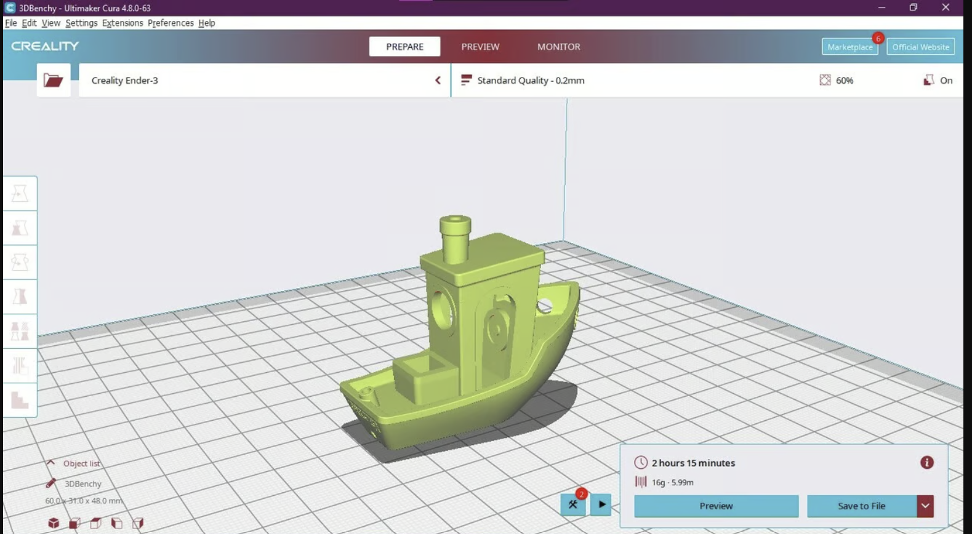
What is Slicing?
Slicing: Converting a 3D model into a format that 3D printers can understand
GENERAL STEPS
Choose a slicing software
  Creality
  Slic3r
  Cura
  KISSlicer
Import an STL file
Adjust printing settings
Export as design G-code

Slide 9
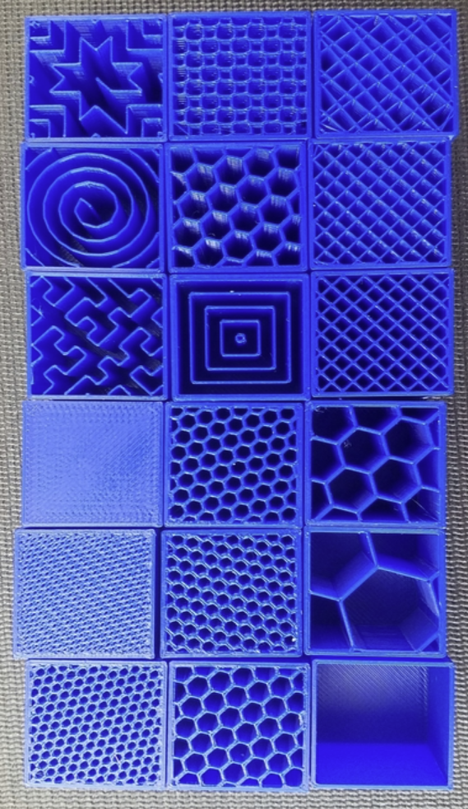
Infill
Infill = Internal structure of a 3D-printed part (solid = 100% infill)
Density Considerations:
  5-10%: Prototyping
  10-20%: Standard
  30-50%: Strong
Patterns:
  Line: Fast and cost-effective
  Grid: Fast and Rigid
  Gyroid: Even strength distribution and allows for filling
  Concentric: Increases flexibility

Slide 10
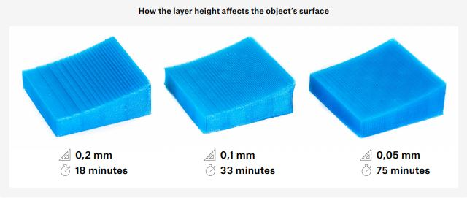
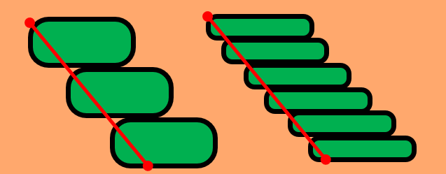
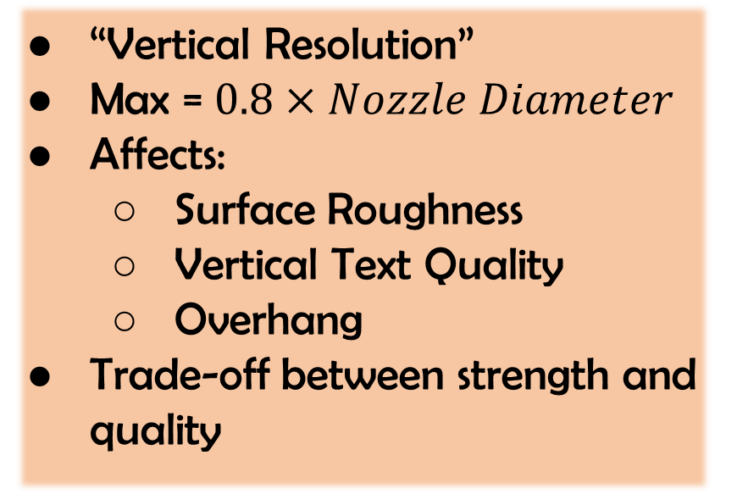
Layer Height
“Vertical Resolution”
Max = $0.8×Nozzle Diameter$
Affects:
  Surface Roughness
  Vertical Text Quality
  Overhang
Trade-off between strength and quality

Slide 11
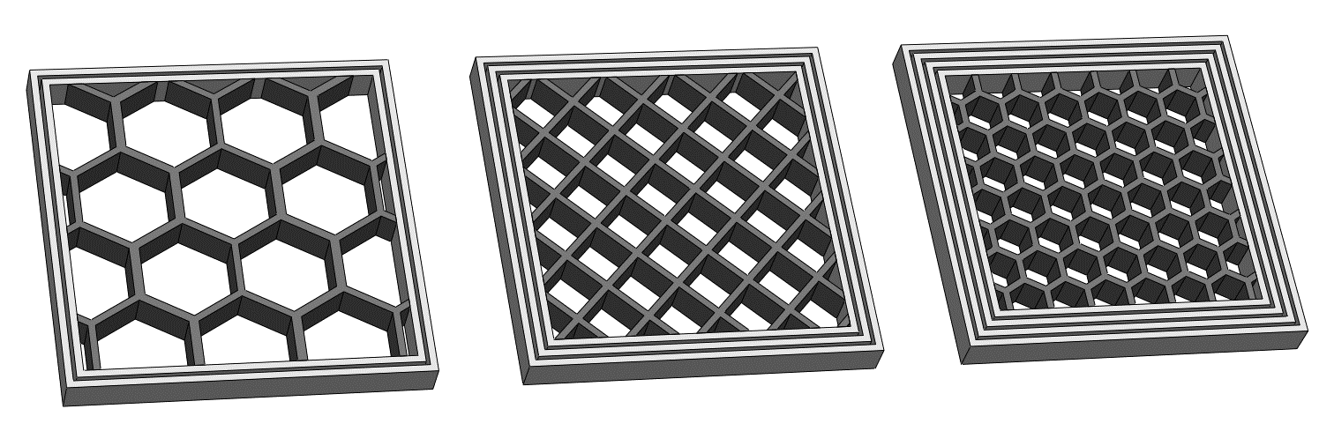
Wall Thickness
Horizontal = Wall/Shell Thickness
  Vertical = Top/Bottom Thickness
Types of Walls:
  Outer (first)
  Inner (not Outer)
Should be a multiple of (at least 2x) nozzle diameter
Disadvantage of increasing wall thickness is wasting time/material

Slide 12
Line
Width
Front
Front
Default = nozzle diameter
Range = ± 20% nozzle diameter
Many types
  Outer Wall Line Width
    Surface features that are ≤ nozzle diameter
  Initial Layer Line Width
  Infill Line Width
    Increases Strength without affecting time
Front
Front

Slide 13

E
Support Material
Supports: Structures that prop up the model
  Applicable to overhangs >45˚ from vertical by default
Settings:
  XY Distance
  Z Distance
  Overhang Angle

Slide 14
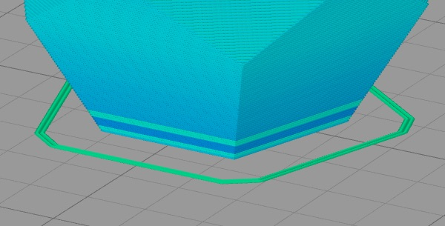
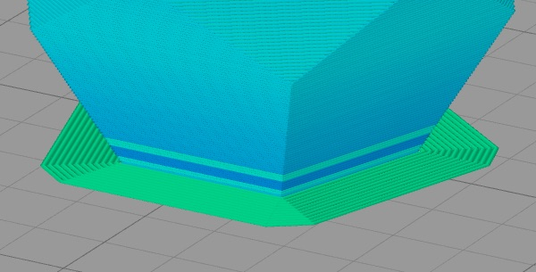
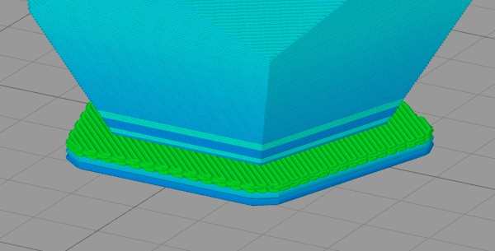
Bed Adhesion
Maximize First Layer Surface Area
Adhesion prevents warping
First Layer Adhesion Options:
  None
  Skirt: Line around the model
  Brim: Flat surface around model
  Raft: Thick platform below model

Slide 15
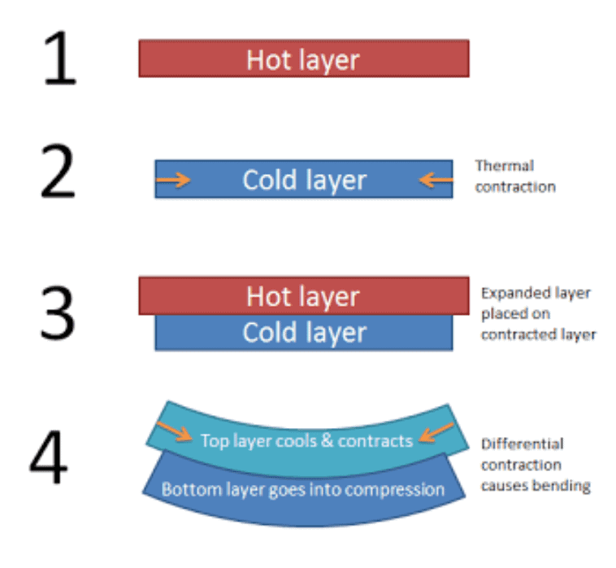
Inaccuracy in Printing
Sources of Inaccuracy
Solutions to Inaccuracy
Part Cooling
Minimum Feature Size
Calibrate the Printer
File Conversion Errors
Adjust Design
Lack of Calibration
Adjust Slicing Parameters
Over/Under-extrusion

Slide 16
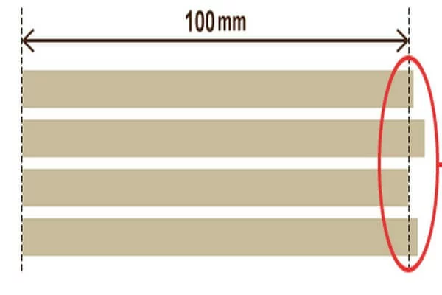
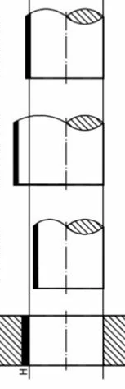
Adjusting Design
Transition Fit
Solutions to Inaccuracy
Interference Fit
Keep printer tolerance in mind:
FDM ≈ ±0.5% (min. = ±0.5 mm)
Choose a type of fit
Clearance Fit
Horizontal > Vertical

Slide 17
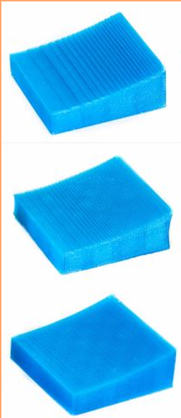
Adjusting Slicing
Solutions to Inaccuracy
Decrease Layer Height
Decrease Speed / Acceleration / Jerk
< 0.6 mm/s, 3000 mm/s², 15 mm/s
Other options:
Outer before Inner walls, coasting

Slide 18

Thank you for Attending!
Resources on our Website!

